Slide 1


Generating Multi-scale Graphs with Graph U-Net
Department of Software Engineering Capstone Project Phase A Braude College of Engineering, Israel Project 24-1-R-9
314761065 Shahar Vachiler Prof. Vladimir (Zeev) Volkovich
205799976 Shachar Dalal Dr. Renata Avros

Slide 2
Agenda
Introduction
Graph U-Nets
Model
Conclusion

Slide 3
Introduction
Graph generation involves using neural networks to create mathematical structures that model relationships between objects.
This process finds wide application in fields like social network analysis, bioinformatics, recommendation systems, chemical compound generation, and traffic flow modeling.
By generating graphs that represent these systems, researchers and practitioners can gain valuable insights that aid in decision-making processes.

Slide 4
The problem
Capturing hierarchical relationships within graph structures can become very complexing.
Existing methods are often inefficient and suffer from many limitations.
The struggle in capturing the complex nuances might lead to incomplete representations of the underlying data.
The overall performance will deteriorate in that circumstances.

Slide 5
Our approach
To address those issues we are going to propose a model based on misc-GAN framework architecture.
The model will use the capabilities of the GU-net model to automate the generation of multi-scale graphs.
Diffusion model for graph generation will also be integrated into our model

Slide 6

Expected achievements
We expect that this approach will surpass existing methods.
We anticipate that the model will be able to accurately capture complex dependencies and distributions inherent in graph data.
The goal is to provide a accessible tool for graph generation with possible applications to citation graphs.

Slide 7
Graph U-nets
The Graph U-nets (GU-nets) is one of the famous deep graph frameworks.
A model is built in a U-shaped architecture.
The model has an encoder-decoder structure that captures complex graph structures .
The model employes gPool, gUnpool, and skip connection operations to achieve this goal.

Slide 8
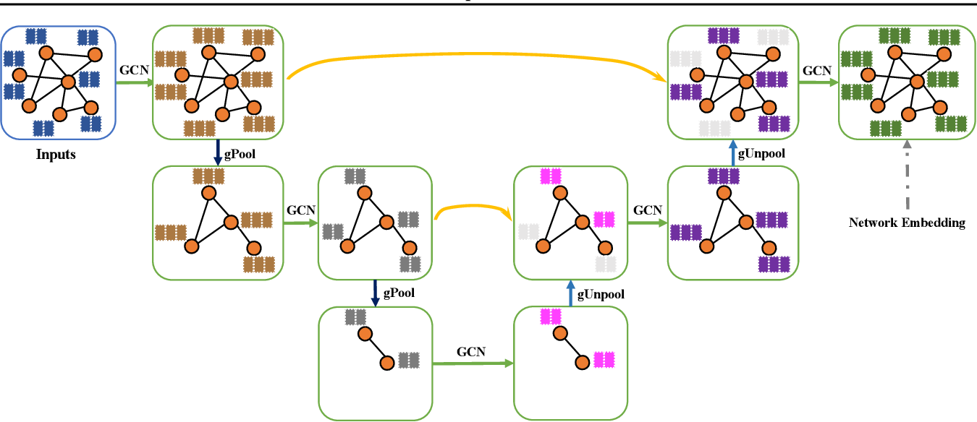
Graph U-nets

Slide 9
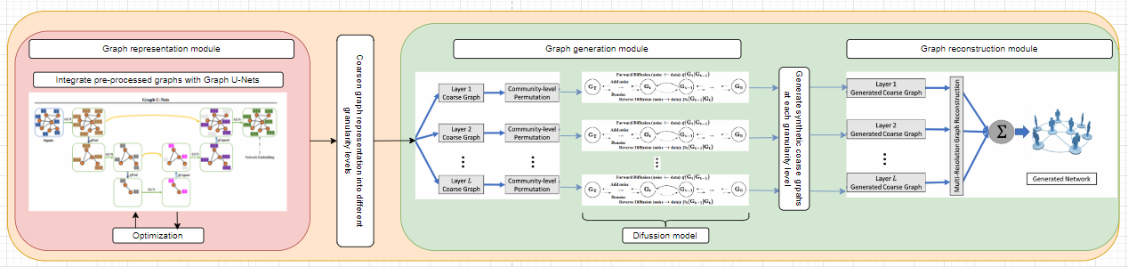
The model

Slide 10
The model
Pre-process – consists of filtering data noises.
Based on the architecture of the misc-GAN model, our model also consists of three main modules:
Graph representation module
Graph generation module
Graph reconstruction module
Testing and evaluation are used to test the output graph by means of various evaluation methods.

Slide 11
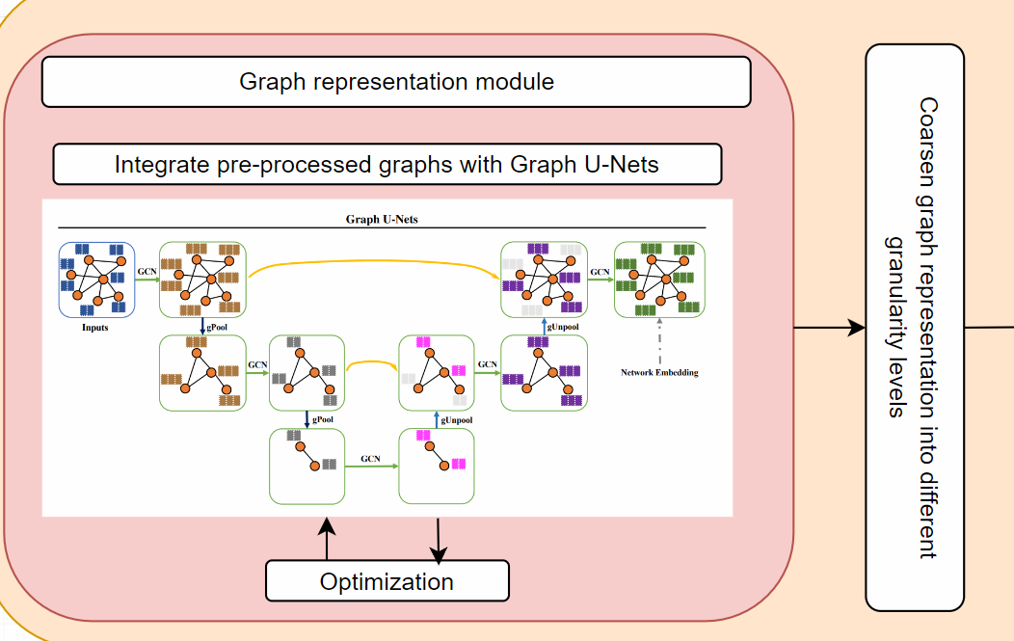
Graph representation module

Slide 12
Graph representation module
The Graph Representation Module is employed in the first stage of the GU-net model, the encoder.
The model is trained on a given set of subgraphs of the predefined source graph.
Aim to refine the input graphs by the encoder process through coarsening stages and to train the model.
This process dynamically adapts to varying graph complexities, facilitating the extraction of hierarchical features.
Additionaly, the output of the encoder process is a presentation of the input graph coarsened by various granularity levels.

Slide 13
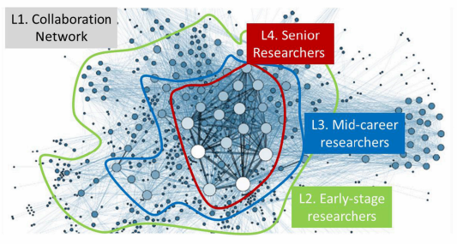
Example
This is an example represents module break down an input graph into different granularity levels:
The plot exhibits four-level hierarchies including (L1) all the entities in the collaboration network, (L2) early-stage researchers, (L3) mid-career researchers and (L4) senior researchers.

Slide 14
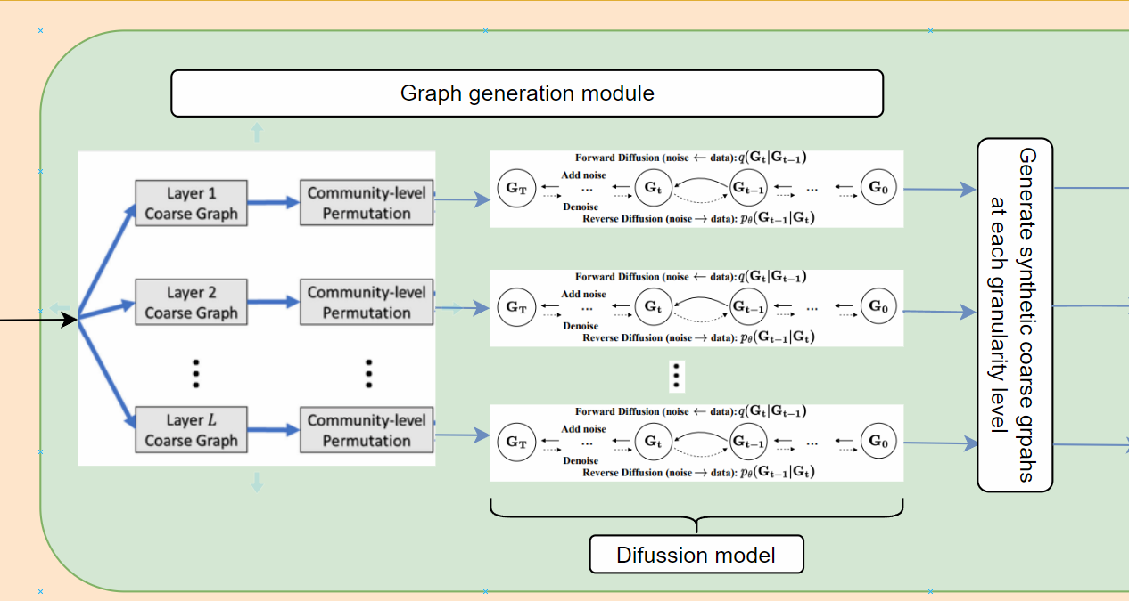
Graph generation module

Slide 15
Graph generation module
This module facilitates the generation of target graphs from each coarsened graph at different granularity levels.
As a result, the module generates various target graphs which are the base of the input of the Graph Reconstruction Module.
This module consist of three steps:
First step: Partitioning the graph into multiple non-overlapping subgraphs.
Second step: Characterize the community-level graph structures by Generating a set of block diagonal metrics from the detected communities.
Third step: Apply diffusion model that will generate graph from each granularity level.

Slide 16
Graph reconstruction module
The Graph Reconstruction Module is employed by the second stage of the GU-net model, the decoder.
The primary objective of this Module is to reconstruct a graph close to the original input graph from its coarsened representations.
Effectively reversing the coarsening operations performed during the encoding phase.
This is achieved through a combination of two key operations: gUnpool and skip connections.

Slide 17
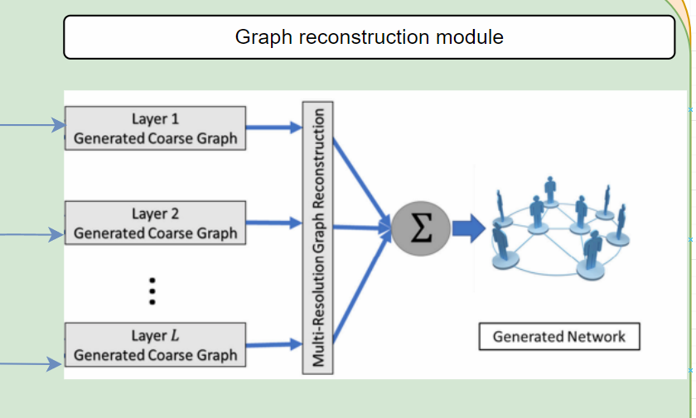
Graph reconstruction module

Slide 18
Measuring for successes
Previous models achieved somewhere between 67% - 84% similarity.
In order for our project to be successful we need to achieve 85% similarity between the graphs.
If we manage to achieve this goal our model will be considered a leading model in miulti-sacle graph generating.
If the result is less than 85% the model needs to be fine-tuned and further tests will be conducted.

Slide 19
Conclusion
We suggest that
The incorporation of GU-Net and diffusion models offers a unique approach to capturing complex patterns within graph structures.
This incorporation enables more effective graph representation learning.
The main objective is to achieve greater efficiency and accuracy compared to previous methods.
Through a careful testing and validation plan, the project seeks to establish the proposed model as a state-of-the-art solution for multi scale graph generation.

Slide 20

Thank you for listening!
Any questions?

